Slide 1
Linear Models

Slide 2
Overview
Linear models.
Parameter estimation.
Linear in the parameters.
Classification.
The nonlinear bits.

Slide 3
Linear models
Linear model has general form
where is the th component of input .
Assume and therefore is the bias.
Can represent lines and planes.
Should ALWAYS try a linear model first!

Slide 4
Parameter estimation
Least squares estimation.
Choose parameters that minimise
Unique minimum…
Optimum when noise is Gaussian.

Slide 5

Least squares cost function

Slide 6
Least squares parameters
Define the design matrix
Then the optimal parameters given by

Slide 7

Example

Slide 8

Example

Slide 9

Example

Slide 10
How can we generalise this?
Consider instead
Where is a nonlinear function of the inputs.
Nonlinear transform of the inputs and then form a linear model (more tomorrow).

Slide 11
Linear in the parameters
A nonlinear model that is often called linear.
Can apply simple estimation to the parameters.
But… it is nonlinear in the basis functions.

Slide 12
Parameter estimation
Define the design matrix
Then the optimal parameters given by

Slide 13

Example

Slide 14
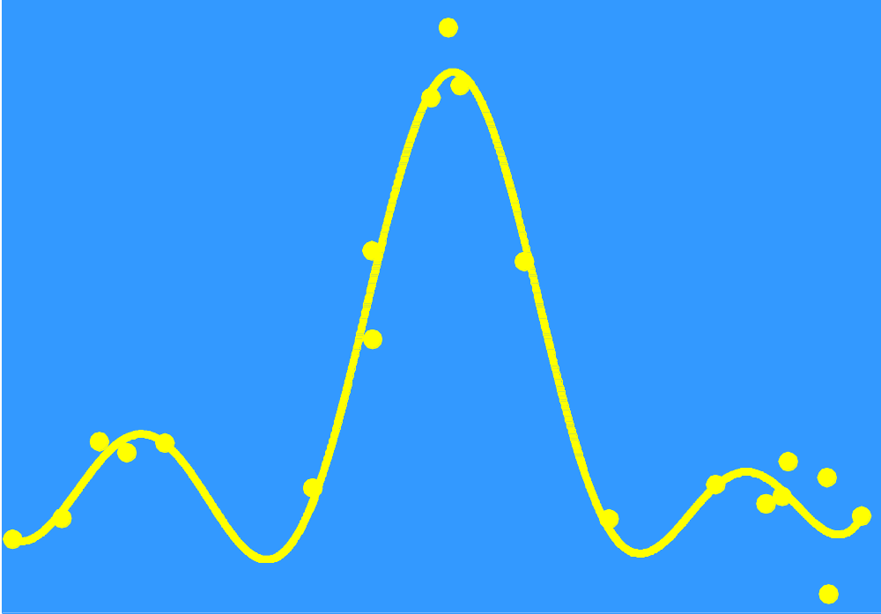
Example

Slide 15
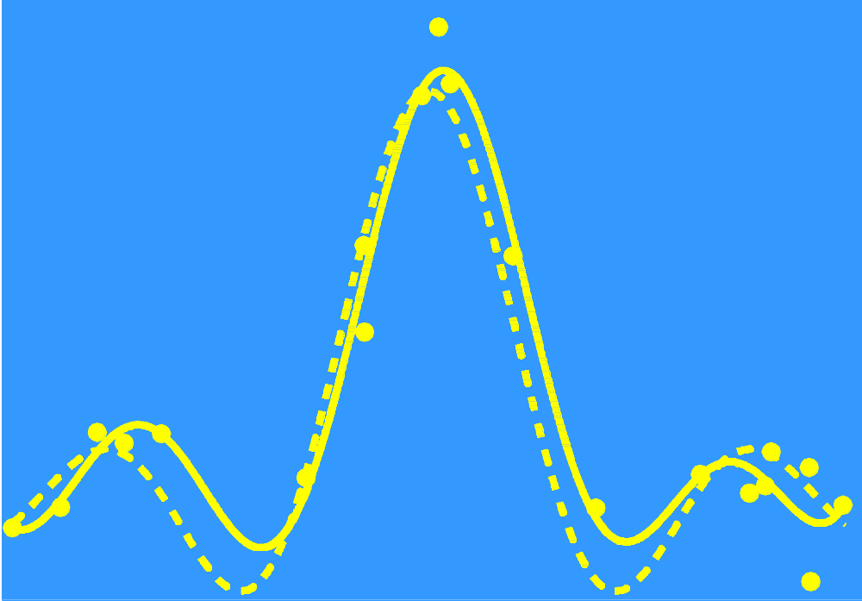
Example

Slide 16

Example – how does it work?

Slide 17

Example – how does it work?

Slide 18
Example – how does it work?
Add all these together
To get the function estimate

Slide 19

Example – when it all goes wrong
More on this later.

Slide 20
Linear classification
How do we apply linear models to classification – output is now categorical?
Discriminant analysis.
Probit analysis.
Log-linear regression.
Logistic regression.

Slide 21
Logistic regression
A regression model for Bernoulli-distributed targets.
Form the linear model
where

Slide 22
Can we generalise it?
Instead of
use a linear in the parameters model

Slide 23
Parameter estimation
Maximum likelihood.
Maximise the probability of getting the observed results given the parameters.
Although unique minimum need to use iterative techniques (no closed form solution).

Slide 24

Example

Slide 25
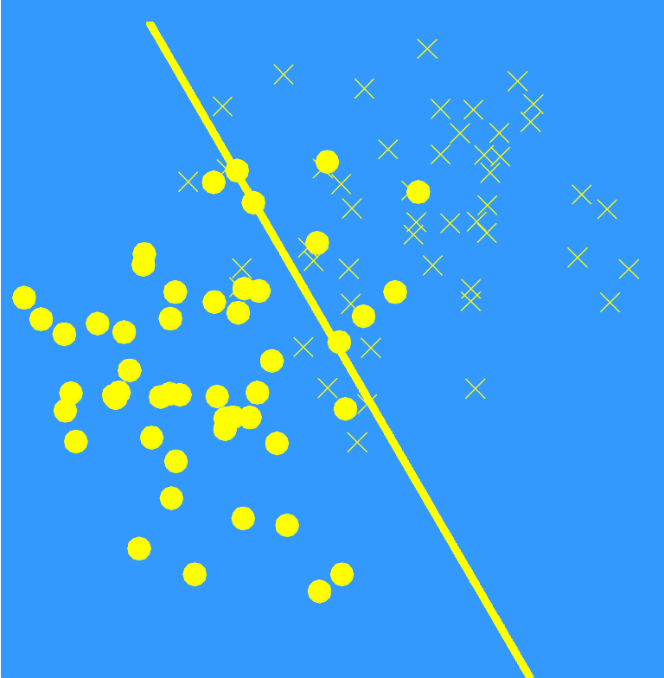
Example

Slide 26
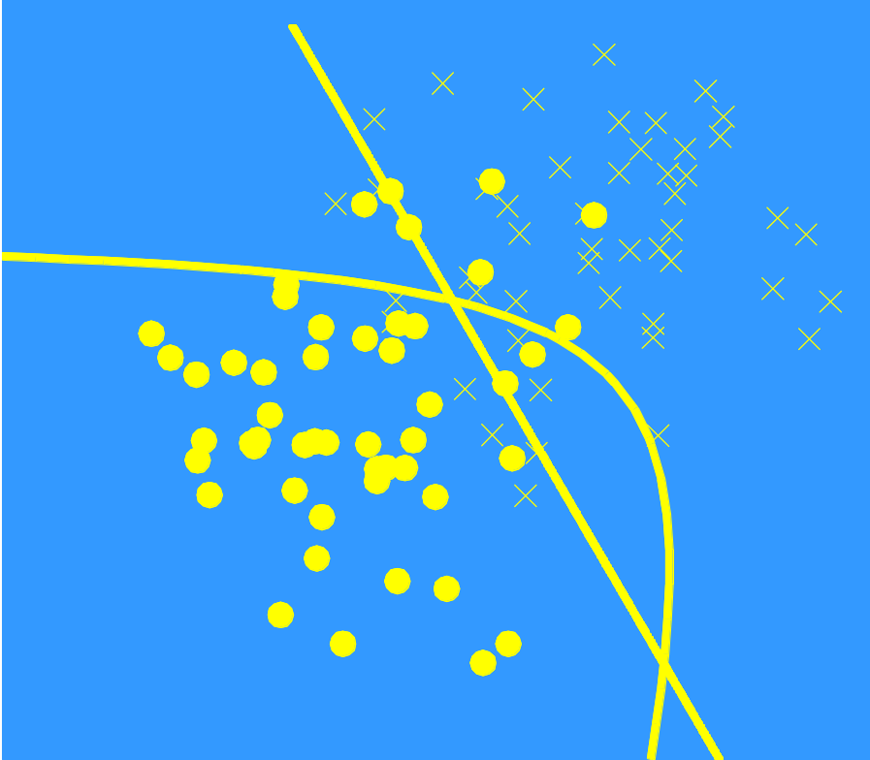
Example

Slide 27

Example

Slide 28

Example – class probabilities

Slide 29



But…

Slide 30
Basis function optimisation
Need to estimate:
Type of basis functions.
Number of basis functions.
Positions of basis functions.
These are nonlinear problems – difficult!

Slide 31
Types of basis functions
Usually choose a favourite!
Examples include:
Polynomials:
Gaussians:
…

Slide 32
Number of basis functions
How many basis functions?
Slowly increase number until overfit data.
Exploratory vs optimal.
More on this in the next talk.

Slide 33
Positions of basis functions
This is really difficult!
One easy possibility is to put one basis function on each data point.
Uniform grid (but curse of dimensionality).
Advantage of global basis functions e.g. polynomials – don’t need to optimise positions.

Slide 34
Concluding remarks
Always try a linear model first.
Can make nonlinear in the input but linear in the parameters.
But becomes nonlinear optimisation.
Is least squares/maximum likelihood the best way?

